Slide 1
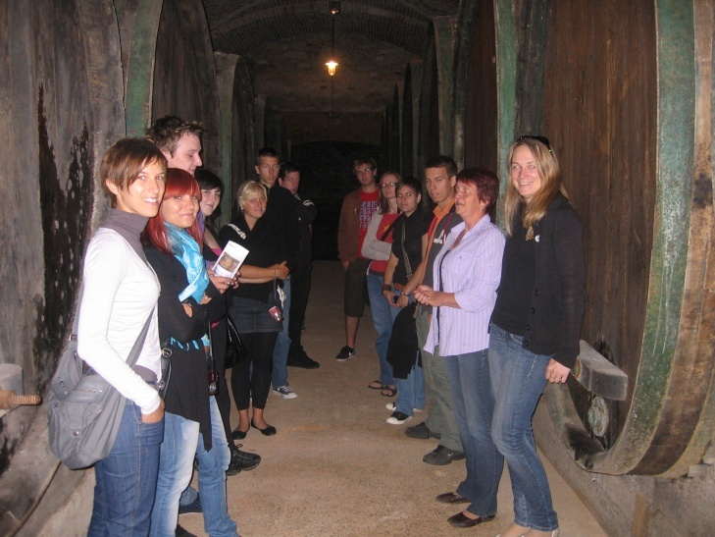
Teennagers & alcohol & wine
mag. Tjaša KOS
Ključarovci, 2013

Slide 2
FACTS ...
In Slovenia:
An alcoholic drink is every drink, containing more than 1,2 vol. %; spirit drink is every alcoholic drink, containing more than 15 vol. %.

Slide 3
FACTS ... ALCOHOL CONSUMPTION
is a risk factor for adverse effects on health, happiness and wellbeing
can have a short-term and long-term medical and social consequences
affects a person's personality, relationships, work capacity, physical and mental health, social status
In particular, the consequences are alarming crossroads of alcoholic beverages in adolescents.

Slide 4
FACTS ... ALCOHOL CONSUMPTION
connected With health in 2 ways:
Alcohol intoxication - Drinking large amounts on each occasion (the cause of injury and self harm)
Long-term excessive consumption of alcoholic beverages (the cause of many chronic non-communicable diseases)

Slide 5
FACTS ... TEENAGERS AND ALCOHOL
The increase in alcohol consumption among young people in Slovenia
Awareness of young people about the harmful effects of drinking alcohol
The increase in planned intoxication as soon as possible

Slide 6
FACT: a number of reasons for alcohol use among adolescents
Method of fun and relaxation
Increased communication skills
Easier grooming
Increased self-confidence
Experiencing happiness
Feeling better acceptance among older peers
Identification with role models (parents, film stars, singers ... )

Slide 7
FACTS ... RESEARCH HBSC
HEALTH BEHAVIOUR IN SCHOOL-AGED CHILDREN
study gaining insight into young people's well-being, health behaviors and their social context
Decreasing age of children who are faced with alcohol for the first time
Lowering the age when adolescents for the first time are drunk
10% of girls (average 13%) of boys and 19% (average 17%) drunk for the first time at 13 years or sooner
among 15-year olds 21% of girls and 36% of boys drink every week

Slide 8
Facts ... Research ESPAD
European School Survey Project on Alcohol and Other Drugs
2011:
Slovenia was above the average for all countries on five of the eight key variables studied and very close to the average on the other three.

Slide 9
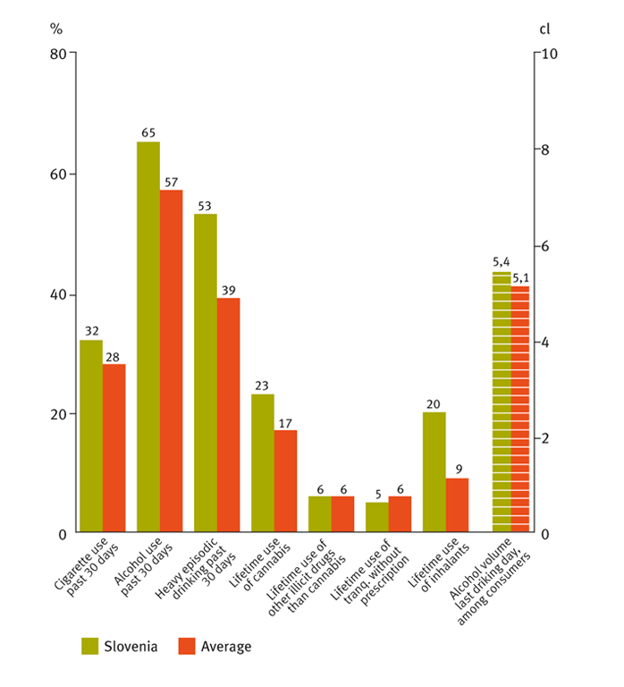

Slide 10
FACTS ... YOUNG KNOWLEDGE ABOUT WINE
158 students (17, 18 years old)
disinterest
ignorance

Slide 11
FACTS ... YOUNG KNOWLEDGE ABOUT WINE

Slide 12
FACTS ... YOUNG KNOWLEDGE ABOUT WINE

Slide 13
FACTS ... YOUNG KNOWLEDGE ABOUT WINE

Slide 14
OUR MISSION
Cultural and Educational Society KELIH was established to bring together the interests of all those who wish to educate and improve in all areas of education, while promote Slovenia as a wine country.
In the name of the society is a culture, education and wine culture as tradition in Slovenia.

Slide 15
ACTIVITIES
4-days Summer School Wine Days
3-days Summer School Wine Days II
Educational tastings for young people
Lectures on elementary schools
Lectures at secondary schools
project RATE IN THE HEAD: flyer and booklet
We teach young people about the cultural wine drinking!

Slide 16
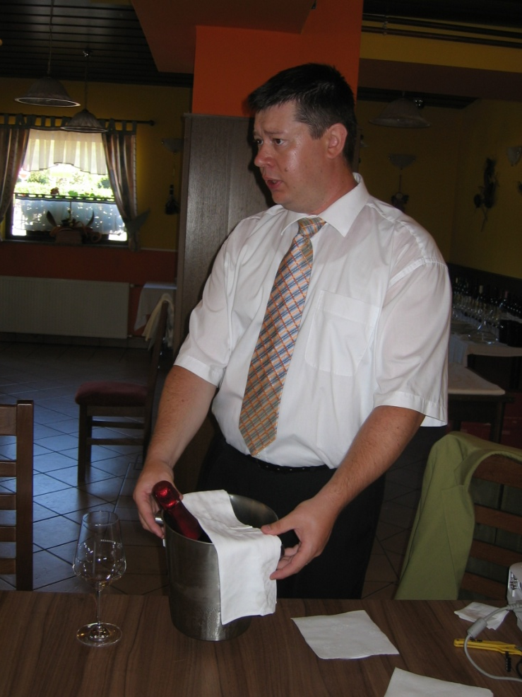
4-days Summer School Wine Days 3-days Summer School Wine Days II

Slide 17
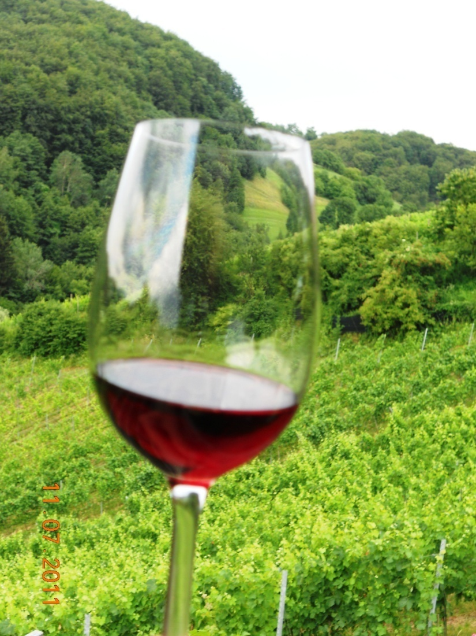
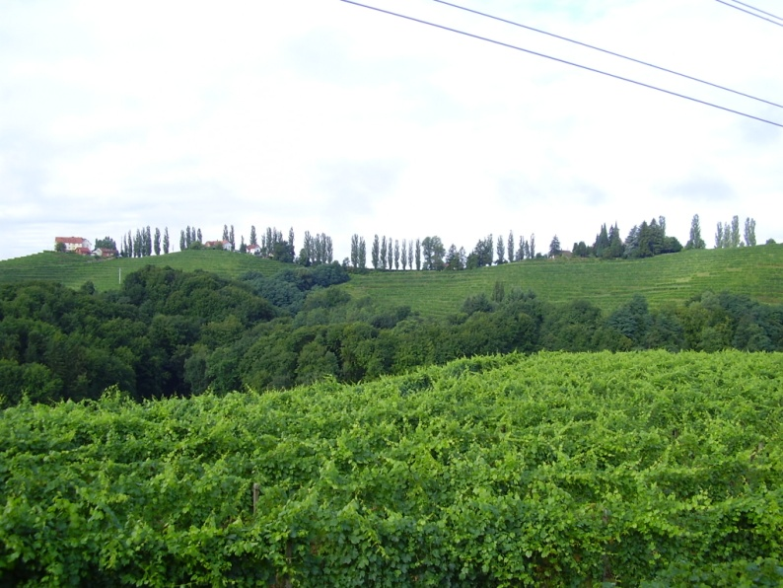
IMPORTANT: The attitude of young people to the wine
Tradition
Cultural Landscape
Important sector in agriculture

Slide 18
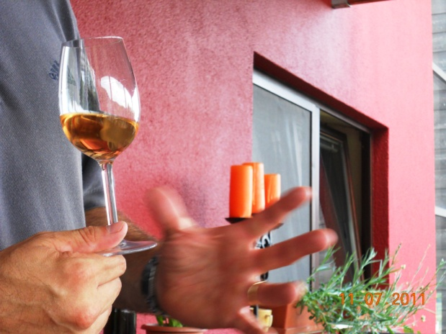
IMPORTANT cultural wine drinking of young
Like yourself, respect the wine.
The drops of pleasure, ruin in a bottle.
The hasty drinking wine – life quickly passes.

Slide 19
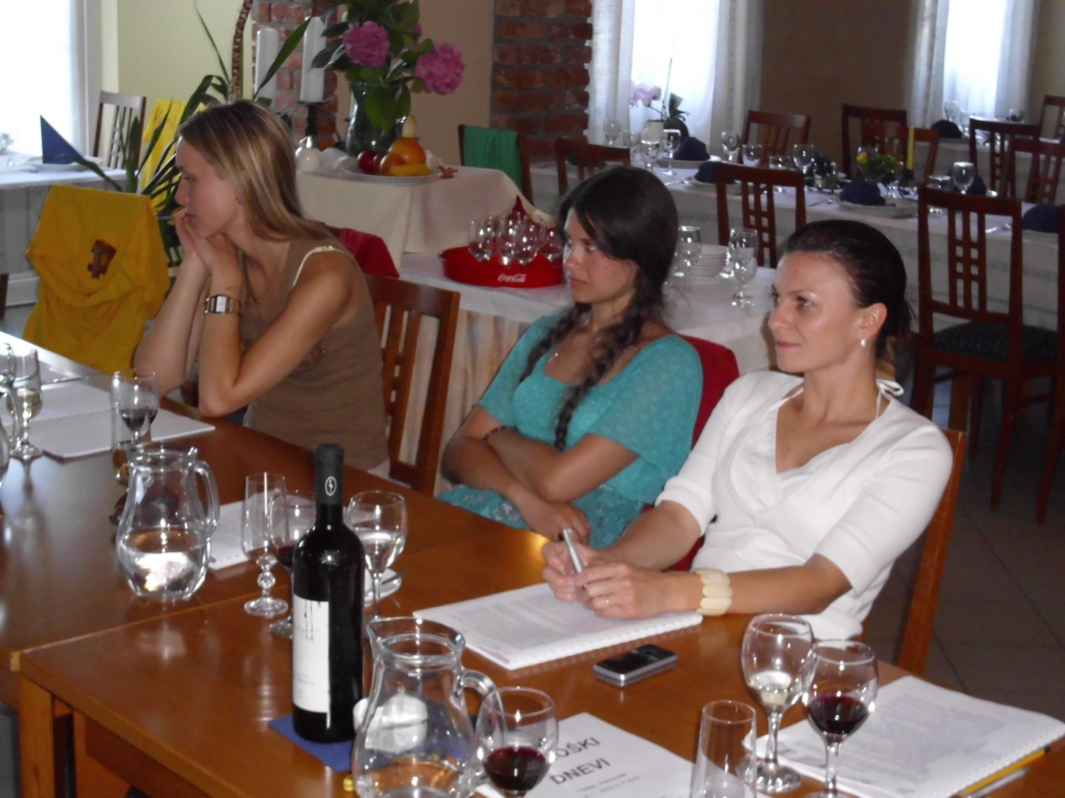
IMPORTANT teaching young people about wine
The basics of viticulture
Basics of wine making
Basics of wine tasting
Glasses, wine temperature
Etiquette at
the table.

Slide 20
IMPORTANT: The young & the wine & food
Wine should be included in the meal like a diamond in the ring.
(French proverb)
I have a lot of space for food and just little for alcohol.
(Katja Koroša)
Anyone who does not drink wine with a meal is deprived of many pleasure. Those who drink wine wrong, spoils the pleasure to themselves and others. (De Richelieu)

Slide 21
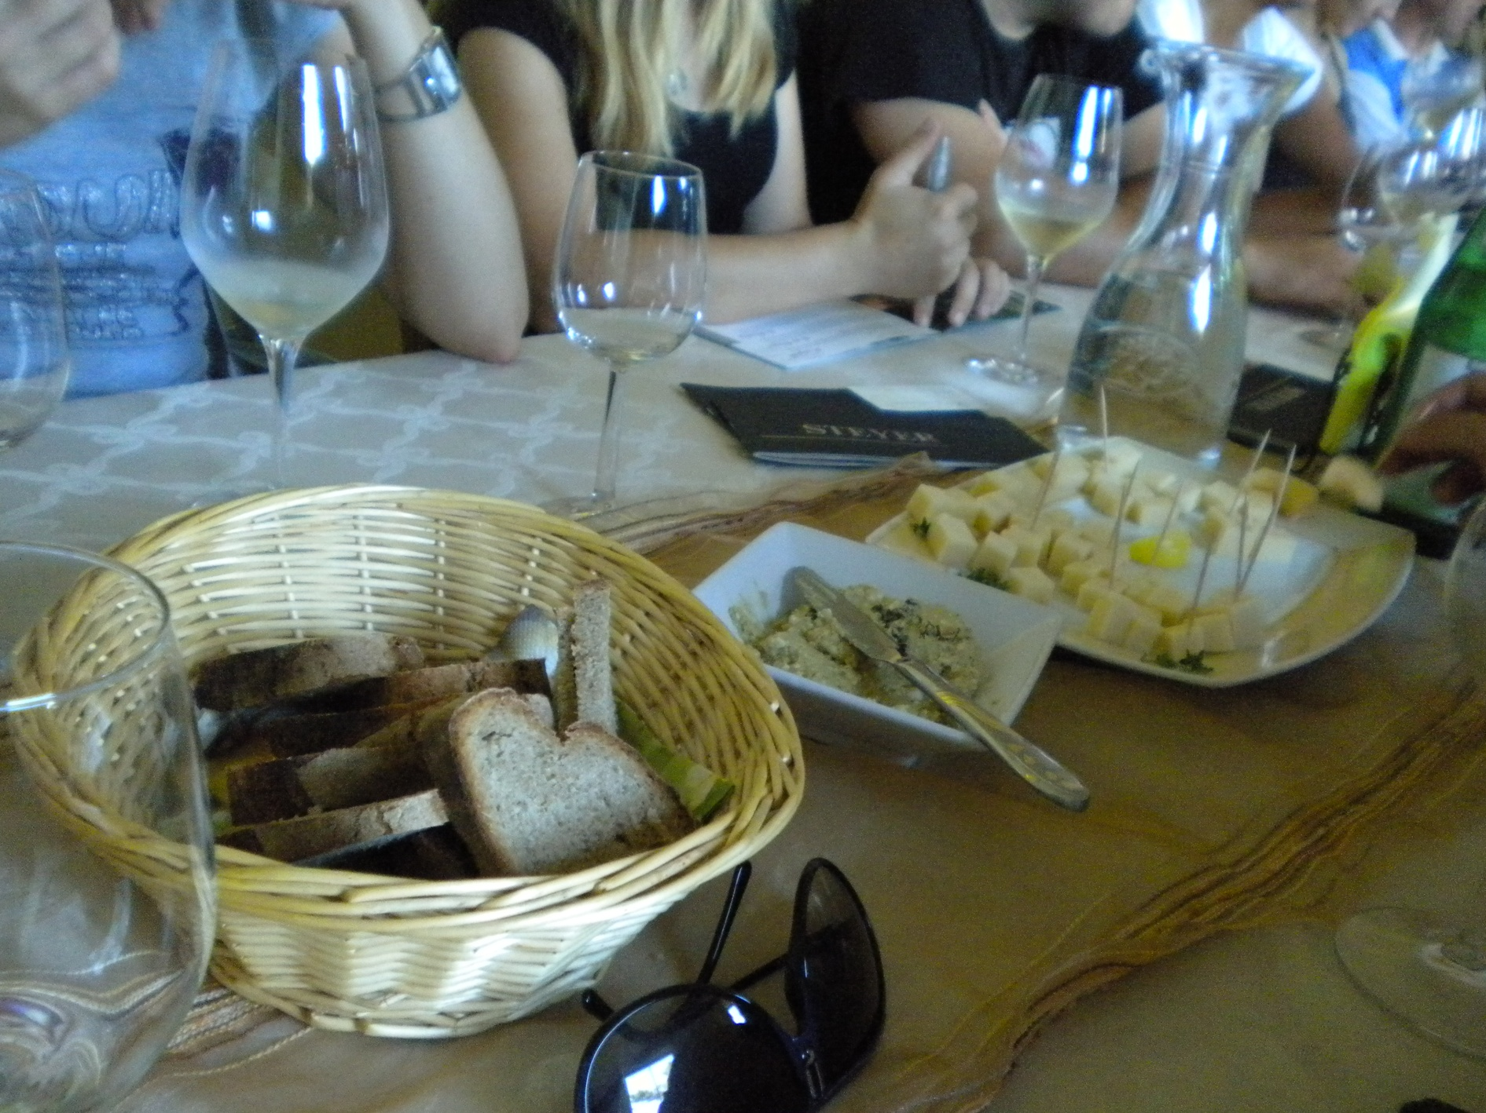

Slide 22
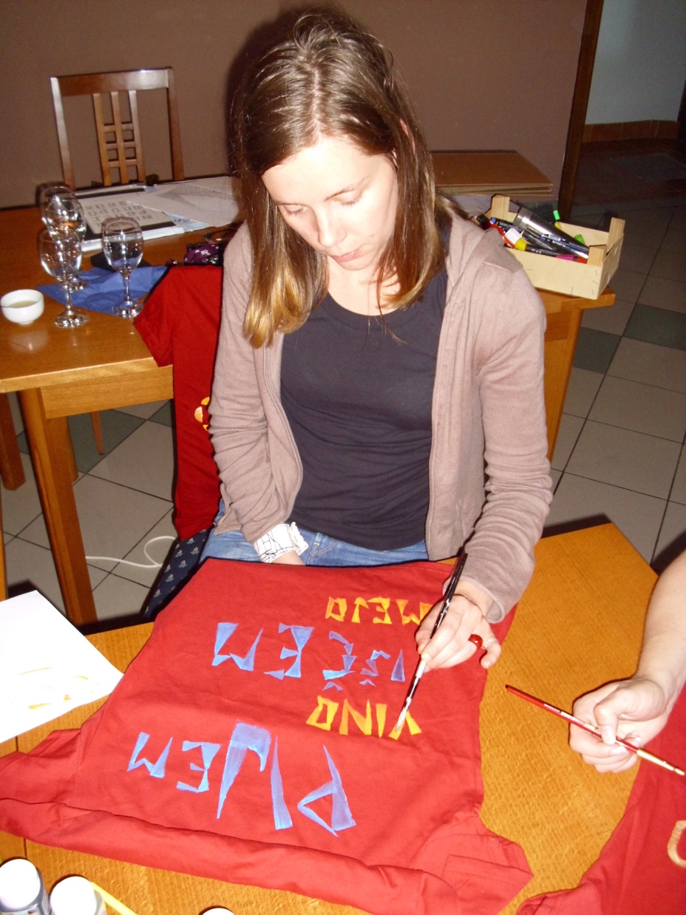
INTERESTING: young people and wine and creativity

Slide 23
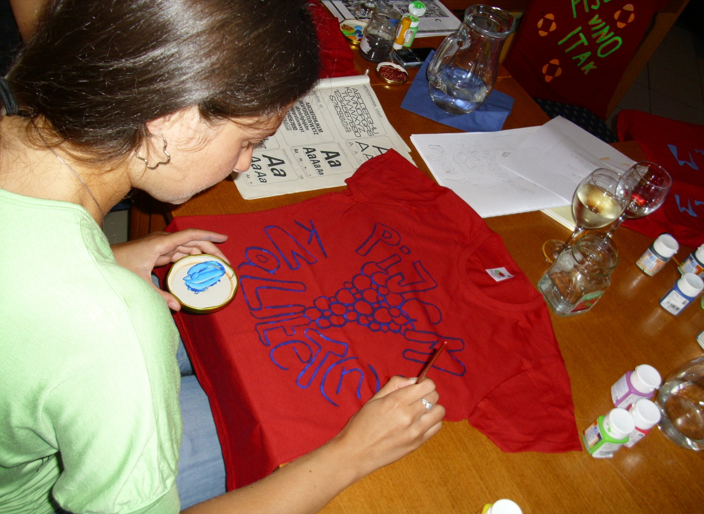

Slide 24
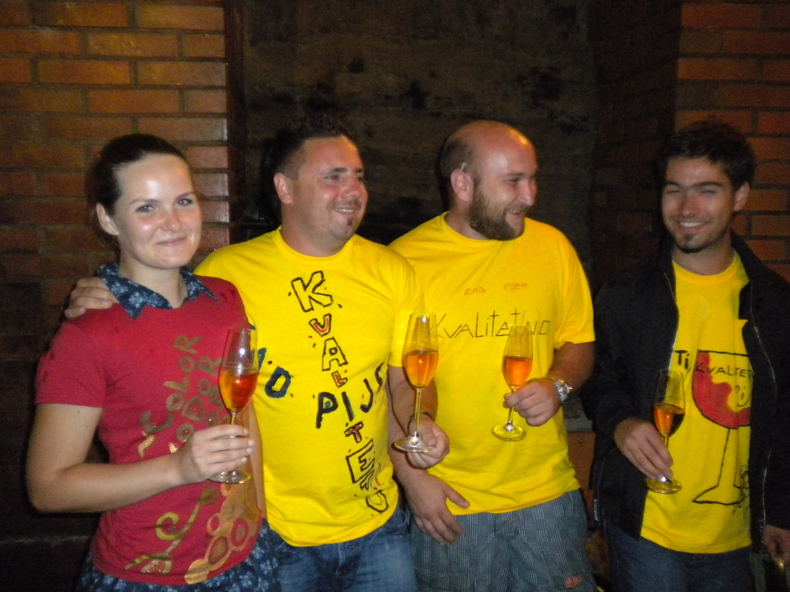

Slide 25
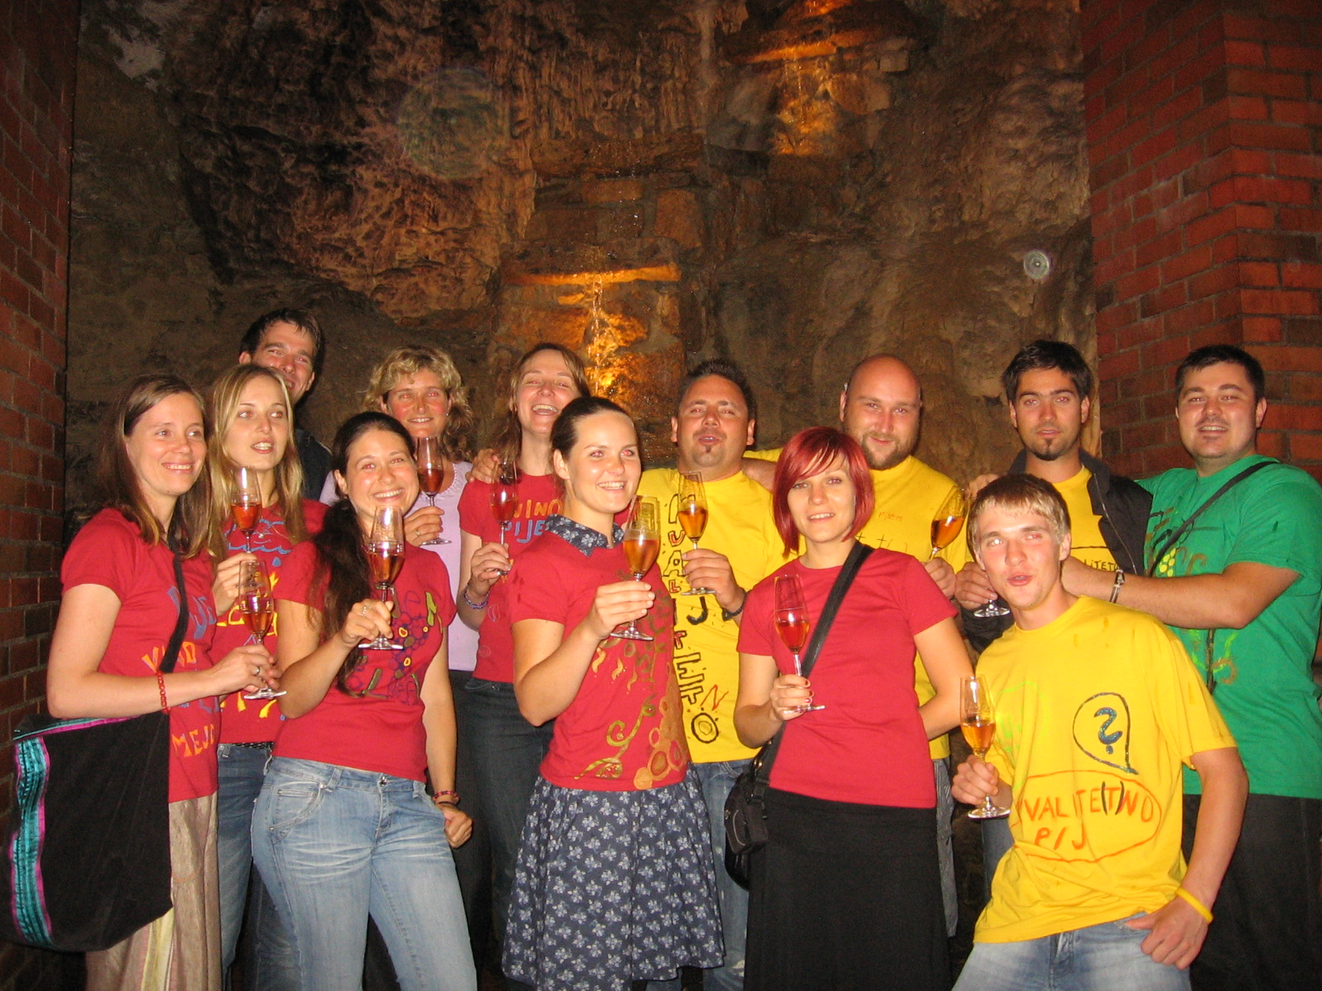

Slide 26
LECTURES IN THE SCHOOL
how to say NO to alcohol
drinking alcohol does not make them more adults and cool
establishment of positions in relation to alcohol
understanding and identifying the causes of drinking alcohol
stimulate thinking about how to have fun without alcohol consumption
the promotion of one's thought and opinions on risky and harmful use of alcohol

Slide 28
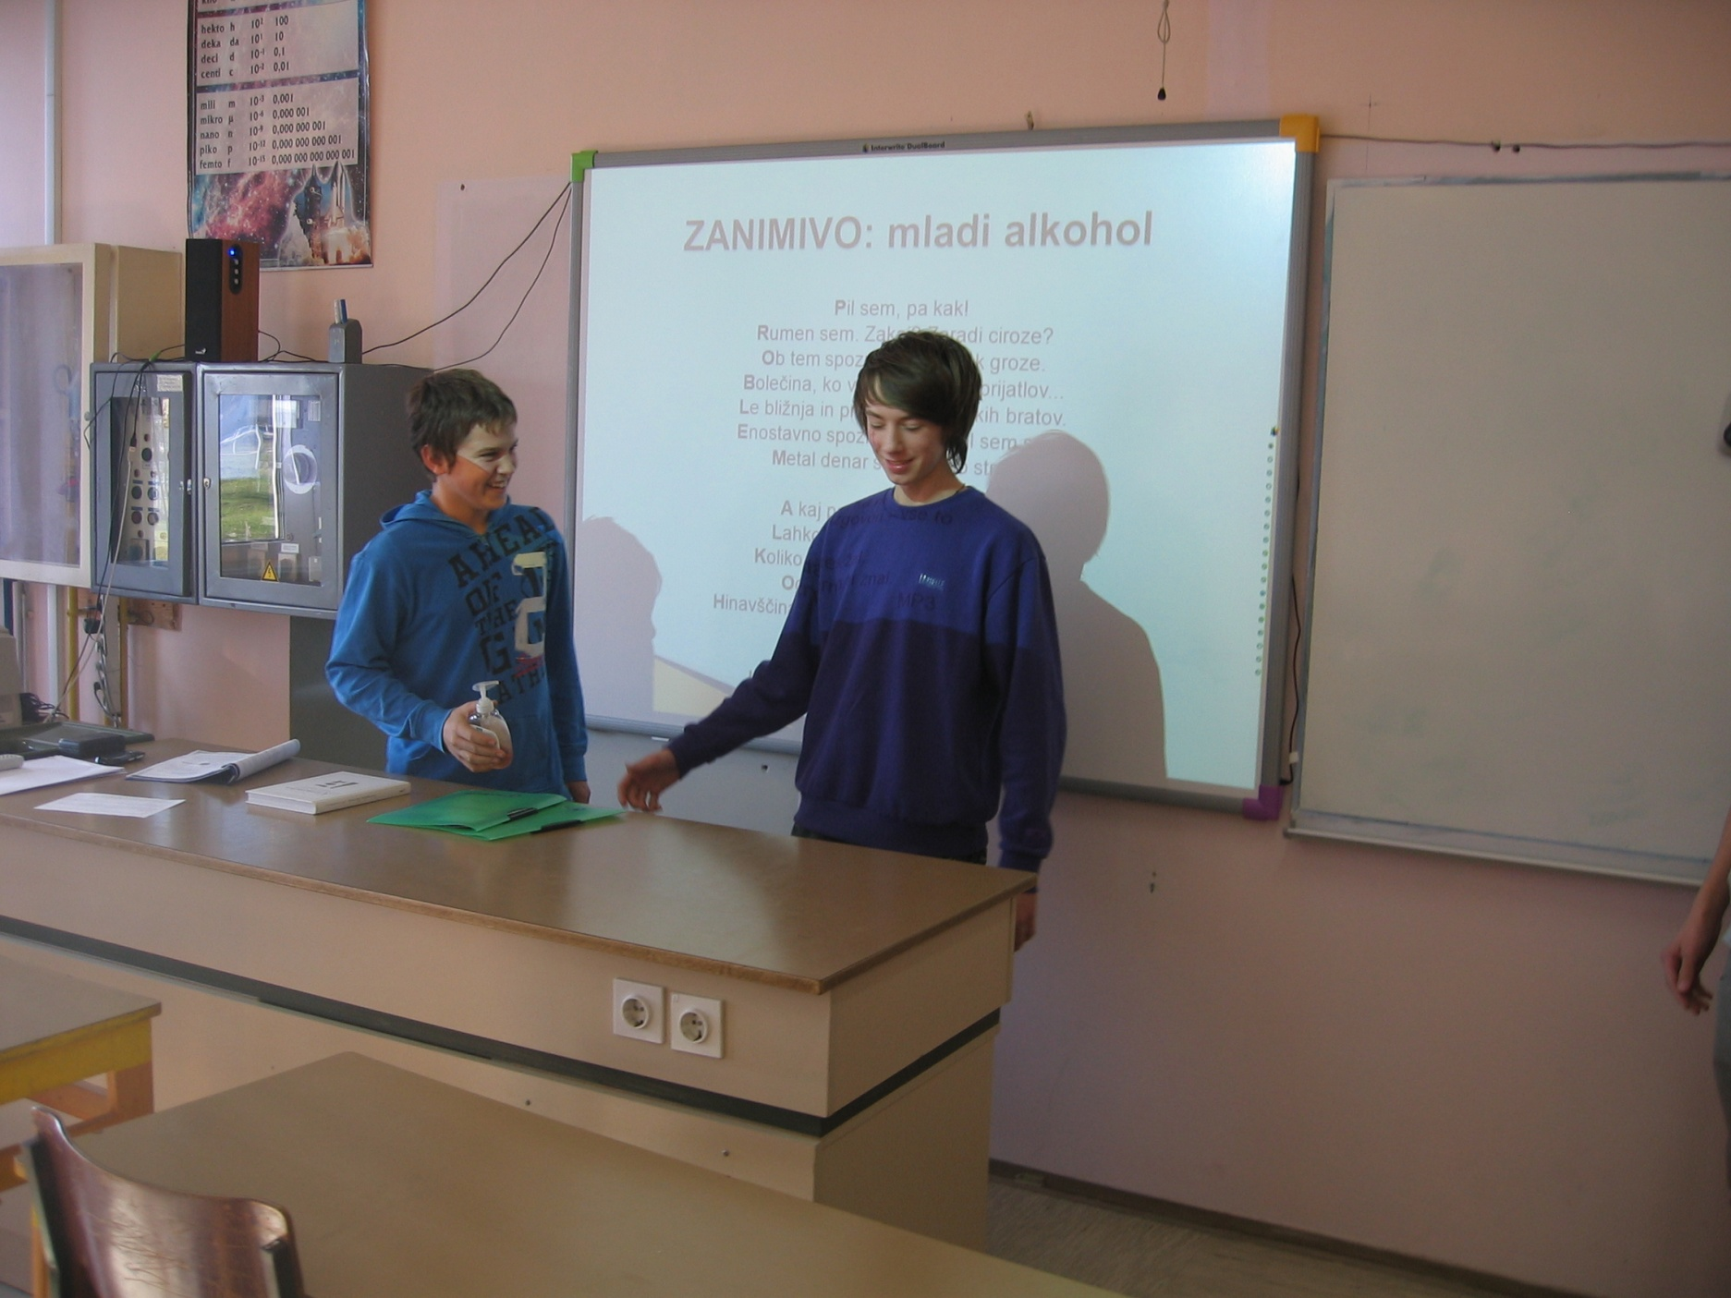

Slide 29
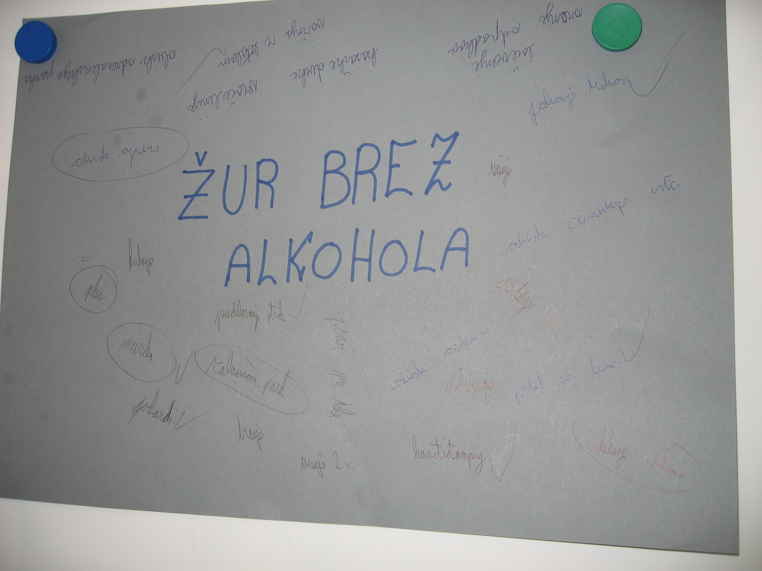

Slide 30
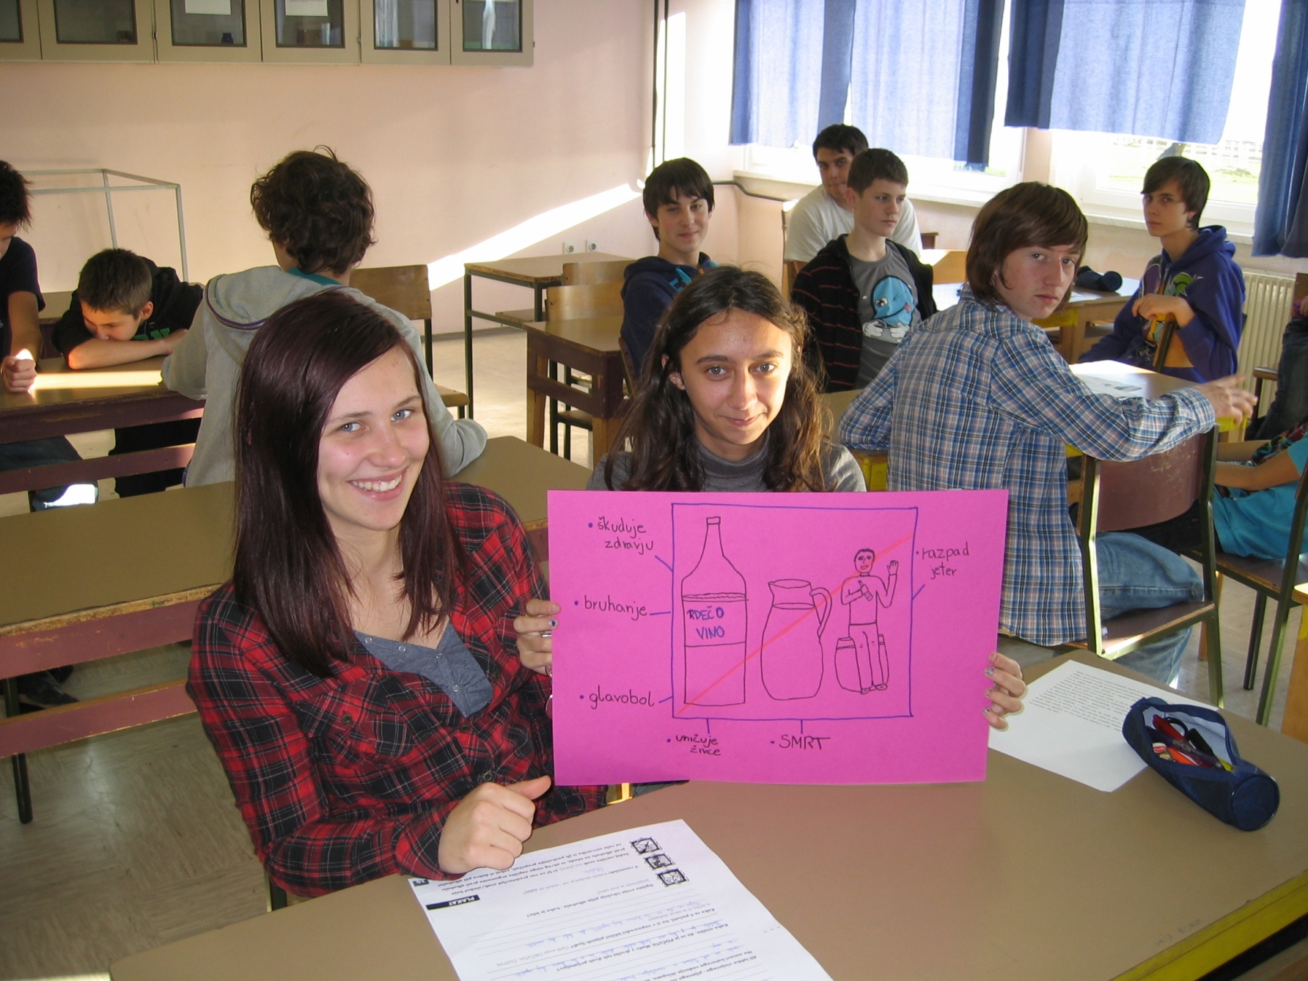

Slide 31
RATE IN THE HEAD

Slide 33
Thank You for Your attention!
KULTURNO IN IZOBRAŽEVALNO DRUŠTVO KELIH
KLJUČAROVCI 66
9242 KRIŽEVCI PRI LJUTOMERU
mail: drustvo.kelih@gmail.com
gsm: 041 357 520
www.kelih.si

